Slide 1
Device Driver & Device Tree
KienLT9
This training materials are reused from multiple sources including FSOFT materials and Freescale training document, public document
Internal Used Only

Slide 2
Agenda
Introduce Platform Driver model
Platform Device
Platform Driver
Device tree
Overview
Basic syntax
Device binding
Accessing DT Information
Compile

Slide 3
Introduce Platform Driver model
Provices a mechanism to notify the kernel of available hardware on board
Mechanism to add the devices to the device model of the kernel
Used for non-discoverable devices
Driver for the devices on the virtual “Platform” bus

Slide 4
Introduce Platform Driver model
Platform Driver
Set of operations done on the device
Platform Device
Information about the device
Deemed to be connected to a virtual “platform bus”

Slide 5
Introduce Platform Driver model
Platform Driver API
#include <linux/platform_device.h> struct platform_driver { int (*probe)(struct platform_device *); int (*remove)(struct platform_device *); void (*shutdown)(struct platform_device *); int (*suspend)(struct platform_device *, pm_message_t state); int (*resume)(struct platform_device *); struct device_driver driver; const struct platform_device_id *id_table; }; int platform_driver_register(struct platform_driver *driver); /* Or, for non hot-pluggable devices */ int platform_driver_probe(struct platform_driver *driver, int (*probe)(struct platform_device *)); void platform_driver_unregister(struct platform_driver *driver);

Slide 6
Introduce Platform Driver model
Platform Device API
#include <linux/platform_device.h> struct platform_device { const char *name; int id; struct device dev; u32 num_resources; struct resource *resource; const struct platform_device_id *id_entry; /* Others omitted */ }; int platform_device_register(struct platform_device *pdev); int platform_device_unregister(struct platform_device *pdev); struct resource *platform_get_resource(struct platform_device *pdev, unsigned int type, unsigned int n); struct resource *platform_get_resource_byname(struct platform_device *pdev, unsigned int type, const char *name); int platform_get_irq(struct platform_device *pdev, unsigned int n);

Slide 7
Introduce Platform Driver model
Platform Device Driver sketup
Init device
#include <linux/init.h> #include <linux/module.h> #include <linux/platform_device.h> #include <linux/device.h> #define DEVICE_NAME "my_device" static struct platform_device my_device = { .name = DEVICE_NAME, }; void __init my_device_init_pdata(void) { /* Register "my-platform-device" with the OS. */ platform_device_register(&my_device); }

Slide 8
Introduce Platform Driver model
Register deriver
static int __init my_driver_init_module(void) { int ret; my_device_init_pdata(); ret = platform_driver_probe(&my_driver, my_driver_probe); //return platform_driver_register(&ineda_femac_driver); return ret; } /* entry point for unloading the module */ static void __exit my_driver_cleanup_module(void) { platform_driver_unregister(&my_driver); // driver_unregister(&my_driver); } module_init(my_driver_init_module); module_exit(my_driver_cleanup_module);

Slide 9
Introduce Platform Driver model
Init Driver
static int my_driver_probe(struct platform_device *pdev) { printk(KERN_ALERT " %s\n", __FUNCTION__); return 0; } static int my_driver_remove(struct platform_device *pdev) { printk(KERN_ALERT " %s\n", __FUNCTION__); return 0; } static struct platform_driver my_driver = { .probe = my_driver_probe, .remove = my_driver_remove, .driver = { .name = DEVICE_NAME, .owner = THIS_MODULE, }, };

Slide 10
Introduce Platform Driver model
Init Driver
static int my_driver_probe(struct platform_device *pdev) { printk(KERN_ALERT " %s\n", __FUNCTION__); return 0; } static int my_driver_remove(struct platform_device *pdev) { printk(KERN_ALERT " %s\n", __FUNCTION__); return 0; } static struct platform_driver my_driver = { .probe = my_driver_probe, .remove = my_driver_remove, .driver = { .name = DEVICE_NAME, .owner = THIS_MODULE, }, };

Slide 11
Device tree
A Device Tree is a hierarchical data structure that describes the collection of devices and interconnecting busses of a computer system.
Device Tree (DT) is language for describing hardware.
Simplest definition: A Data Structure

Slide 12
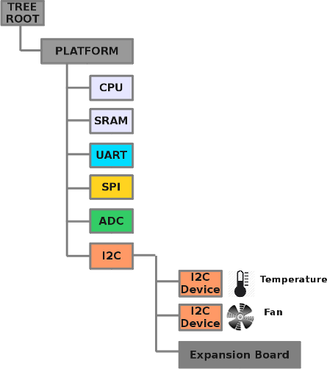
Device tree
Represent hardware configuration
in hierarchical way.
- Each node is named
- Each node has exactly one parent node
- Each node has properties containing data

Slide 13
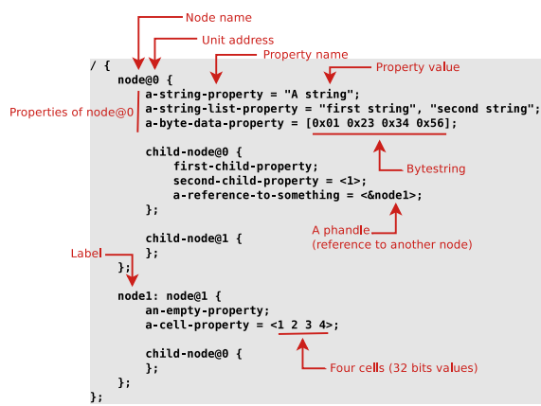
Device tree
Basic Syntax
Notes:
Each node in the device tree has a name according to the following convention:
name@unit-address
The name component specifies the name of the node
The unit-address component of the name is specific to the bus type on which the node sits.
-- unit-address must be unique
-- should match the first address specified in the reg property of the node.
Data type
<u32> -- A 32-bit integer in big-endian format .
Example: the 32-bit value 0x11223344 would be represented in memory as:
address 0x11
address+1 0x22
address+2 0x33
address+3 0x44
<u64> -- A 64-bit integer in big-endian format
Example: the 64-bit value 0x1122334455667788 would be represented as two cells as: <0x11223344 0x55667788>.
<string> -- Strings are printable and NULL-terminated
<phandle> -- Reference to another node in device tree
<stringlist> -- A list of <string> values concatenated together

Slide 14
Device tree
Step to create new device tree
Define a compatible string
Use the standard properties as applicable for the new device.
Use the conventions if the new device fits into one the ePAPR defined device classes.

Slide 15
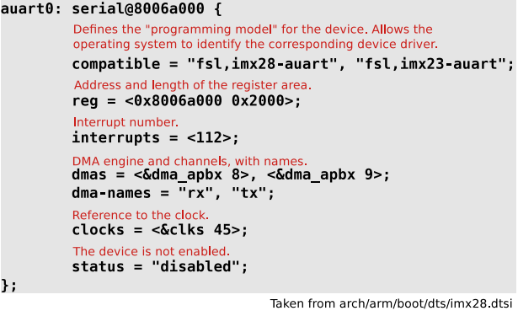
Device tree
TODO : Update new example

Slide 16
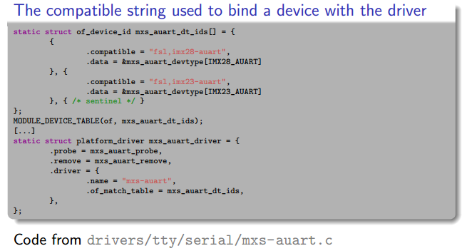
Device tree
TODO : Update new example

Slide 17
Device tree
Accessing DT Information
Bootstrap code uses DT
Serial port type, location
Host bridge setup
finddevice(), getprop() calls used to retrieve information from the DT
The pointer to DT binary representation is passed in r3 to the Linux kernel
Rich set of API calls to retrieve information from the DT (arch/powerpc/kernel/prom.c)
Some API calls also included in arch/powerpc/kernel/prom_parse.c
of_find_compatible_node(), find node based in token in “compatible” property
of_get_property(), find property given node and property name
of_find_node_by_type(), searched for node given “device_type” property
of_translate_address(), translates address from DT to CPU physical address:
At run time the DT

Slide 18
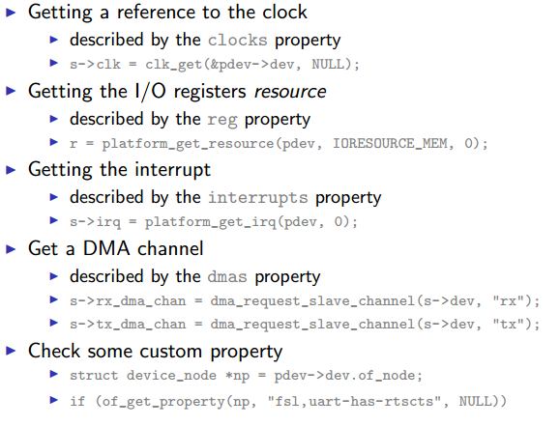
Device tree
TODO : Update new example

Slide 19
Device tree
Compile

Slide 20
Thank You!

